Slide 1

API GATEWAY ZUUL

Slide 2
Module Outline
The need for API Gateway
Spring Cloud Netflix Zuul
Authentication and Security
Insights and Monitoring
Dynamic Routing
Load Shedding
Static Response handling

Slide 3
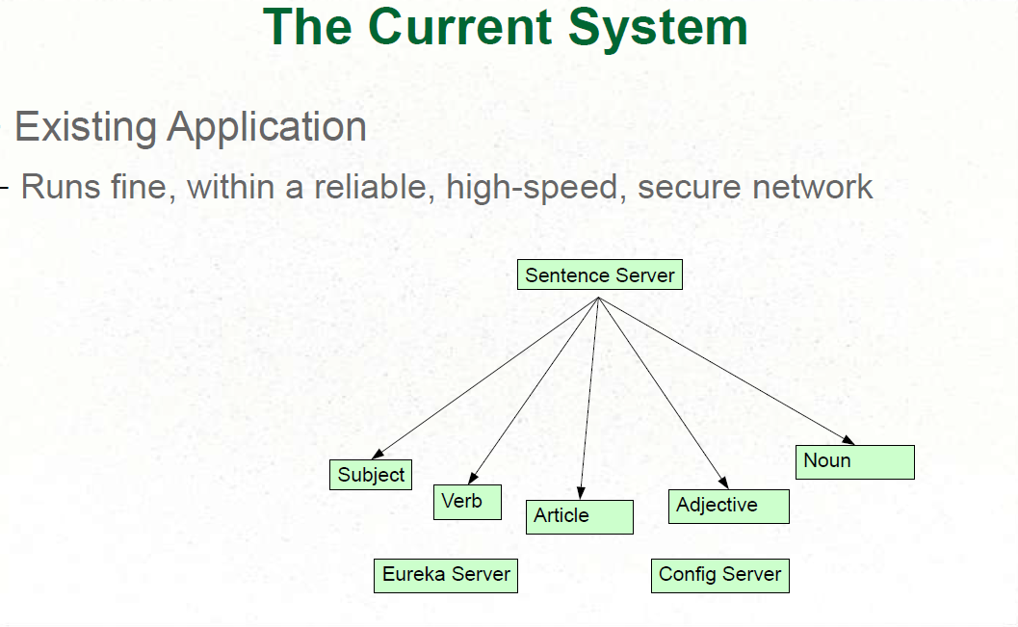

Slide 4
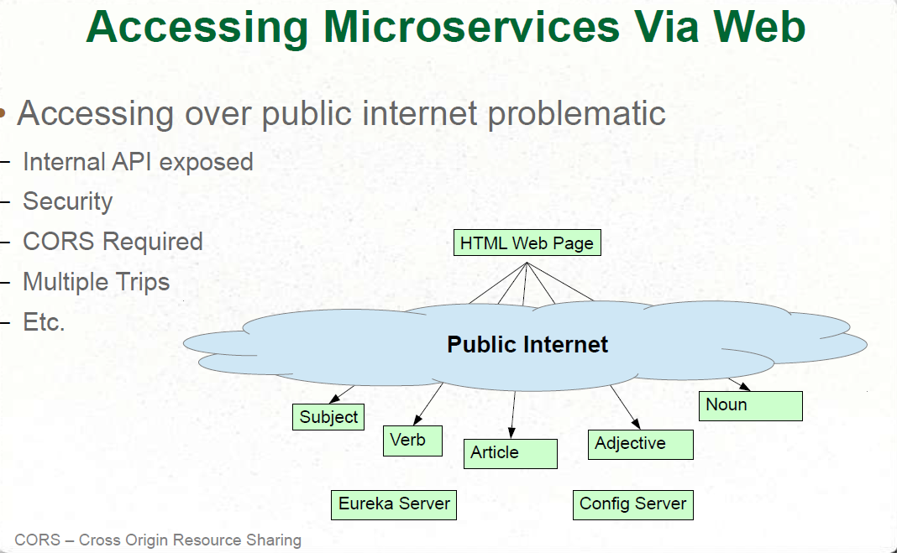

Slide 5
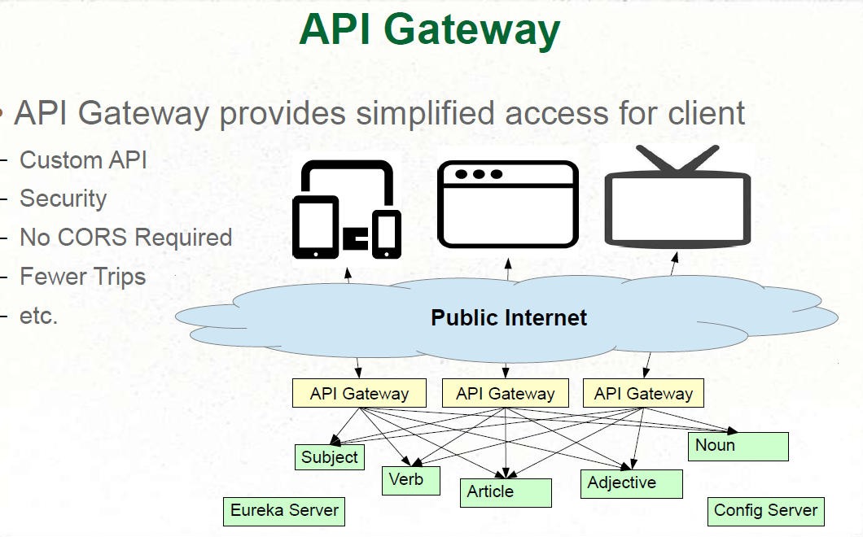

Slide 6
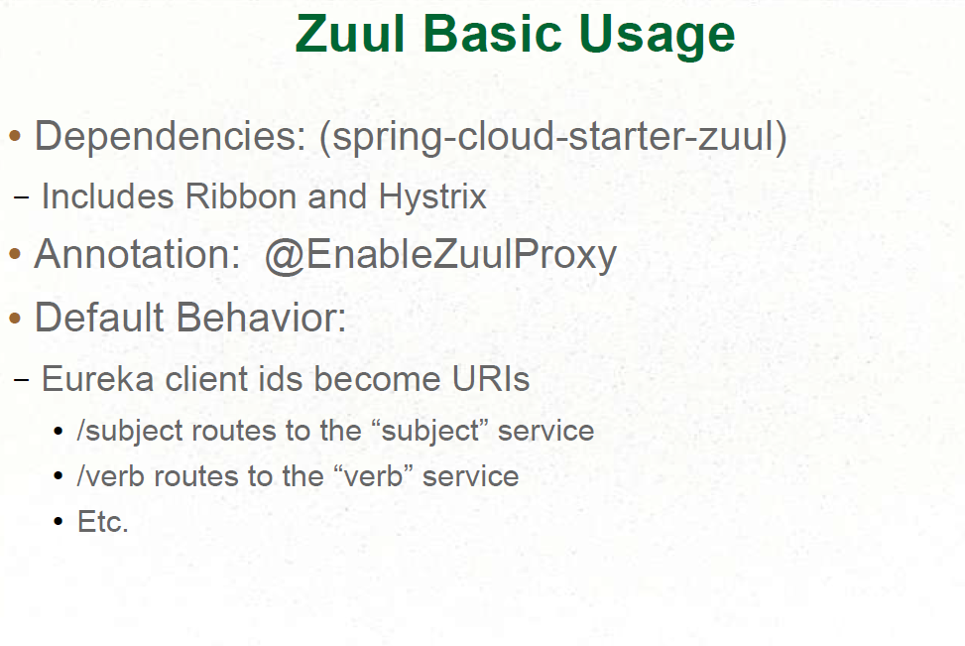
Zuul Implementation

Slide 7
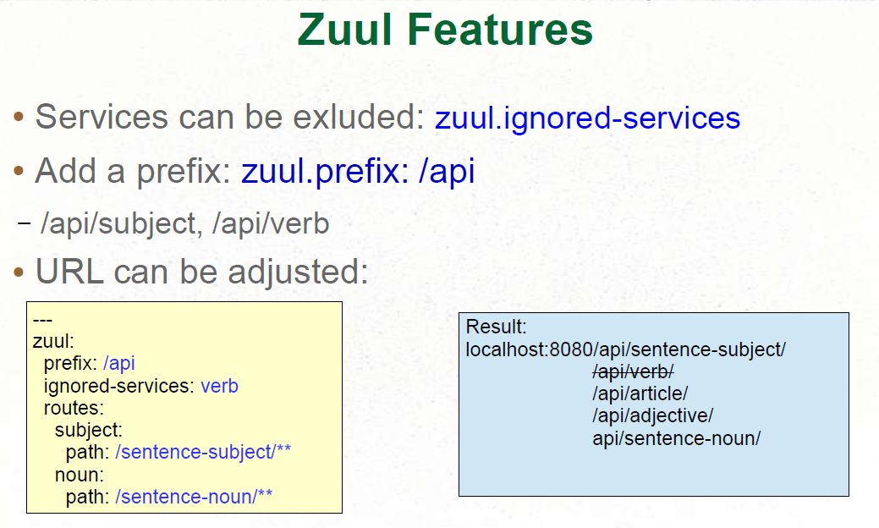

Slide 8
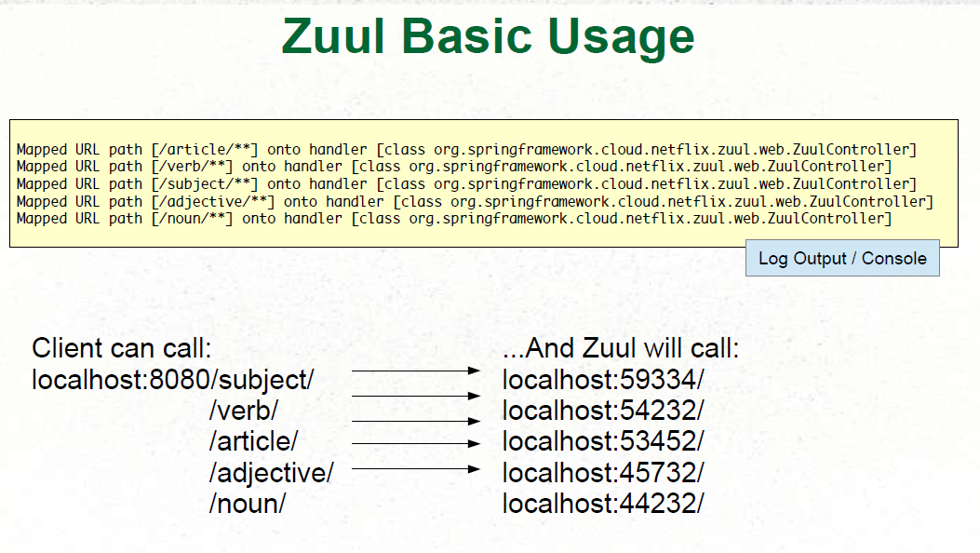

Slide 9
Hystrix Fallbacks for Routes in Zuul
In Zuul all the routes we configure that use Ribbon are also wrapped in Hystrix commands
Hystrix provides a circuit breaker for all your proxied requests through Zuul
Provide a bean that implements ZuulFallbackProvider and specify the route ID you want the fallback and return ClientHttpResponse object when the fallback is invoked

Slide 10
Zuul Filter key characteristics
Type: most often defines the stage during the routing flow when the Filter will be applied (although it can be any custom string)
Execution Order: applied within the Type, defines the order of execution across multiple Filters
Criteria: the conditions required in order for the Filter to be executed
Action: the action to be executed if the Criteria is met

Slide 11
Filter Types
PRE Filters execute before routing to the origin. Examples include request authentication, choosing origin servers, and logging debug info.
ROUTING Filters handle routing the request to an origin. This is where the origin HTTP request is built and sent using Apache HttpClient or Netflix Ribbon.
POST Filters execute after the request has been routed to the origin. Examples include adding standard HTTP headers to the response, gathering statistics and metrics, and streaming the response from the origin to the client.
ERROR Filters execute when an error occurs during one of the other phases.

Slide 12
